Slide 1
AI Demonstrations

Slide 2
Google Quick, Draw!

Slide 3
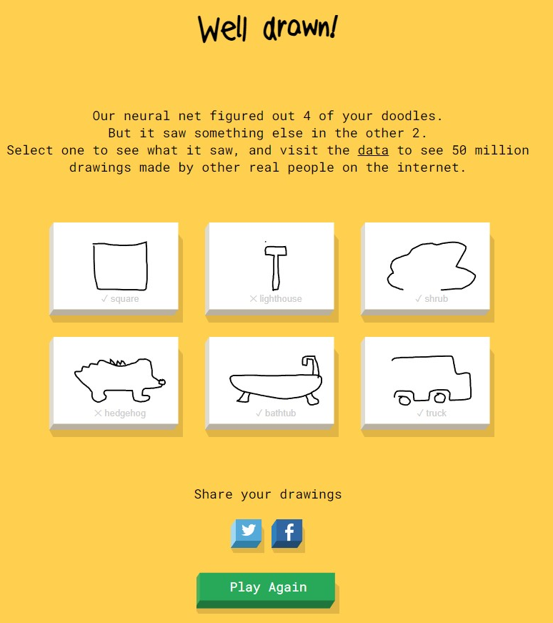
Quick, Draw!
Quick Draw! is a neural network created by Google
You will be given six random prompts, one at a time, to draw using your mouse
The network's goal is to quickly recognize what you are drawing

Slide 4
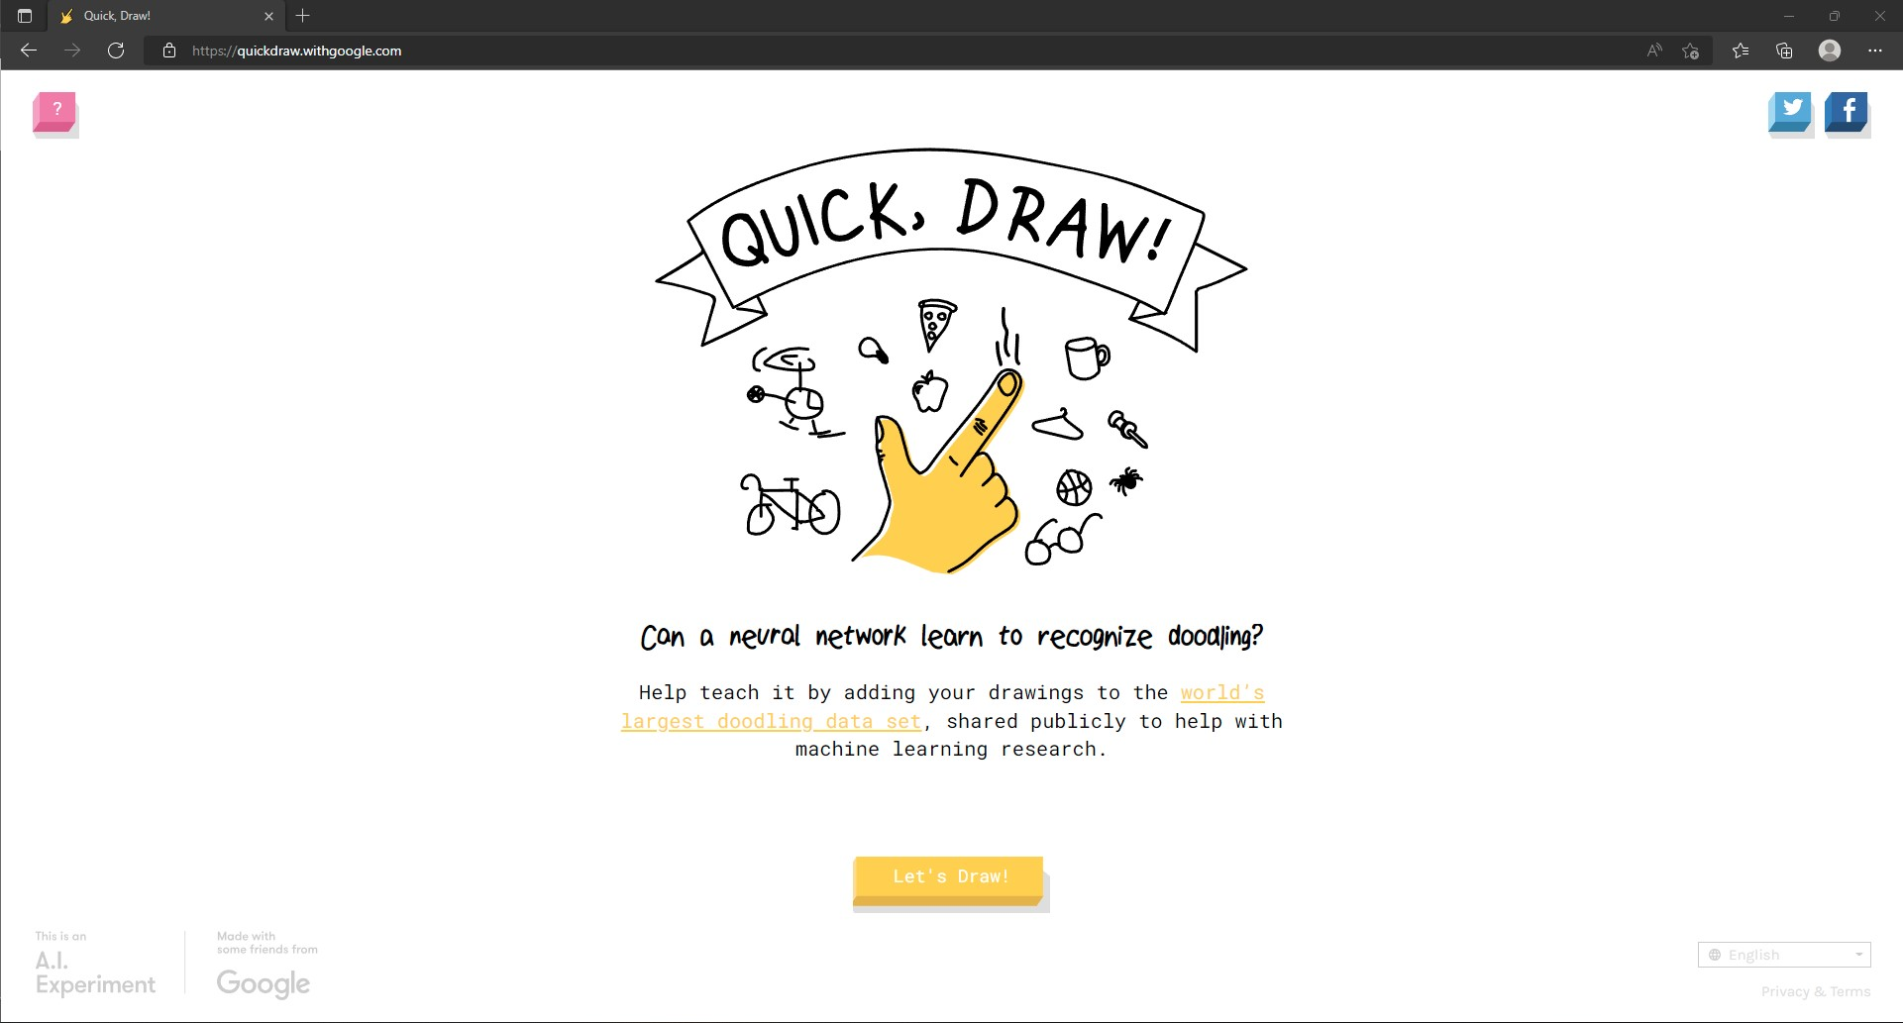
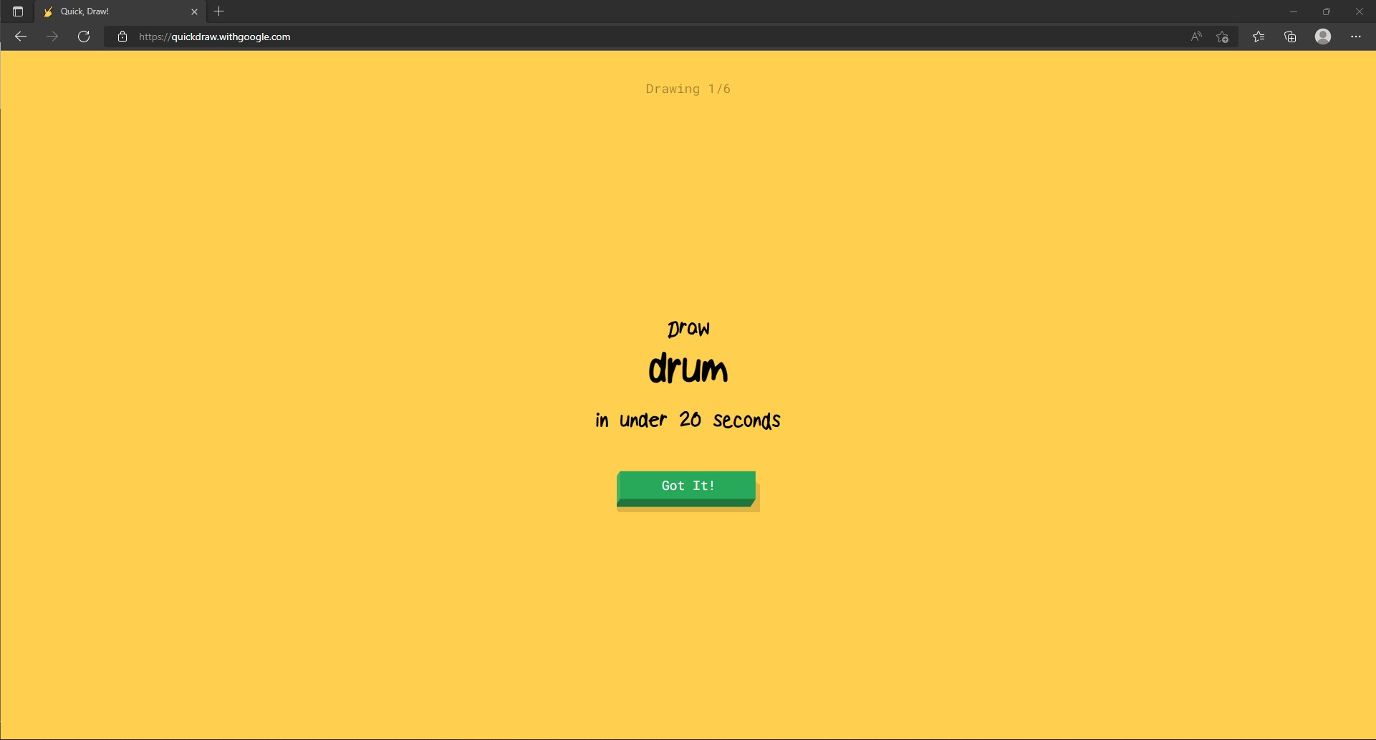
Quick, Draw!
Navigate to the link below using a web browser
https://quickdraw.withgoogle.com/

Slide 5
Discuss with the person next to you
How many of your drawings did the network guess correctly?
Did it get any guesses wrong?
Can you guess why this network performs the way it does?

Slide 6
How does this work?
Google is building their Quick, Draw! model by collecting every drawing that people submit and learning from each pen stroke
Every time someone plays the game, the model is given more data to learn from
So far, the dataset is a collection of over 50 million drawings across 345 different categories
Lots of other applications like Alexa or Siri, self-driving cars, or YouTube recommendations use similar approaches

Slide 7
Scroobly

Slide 8
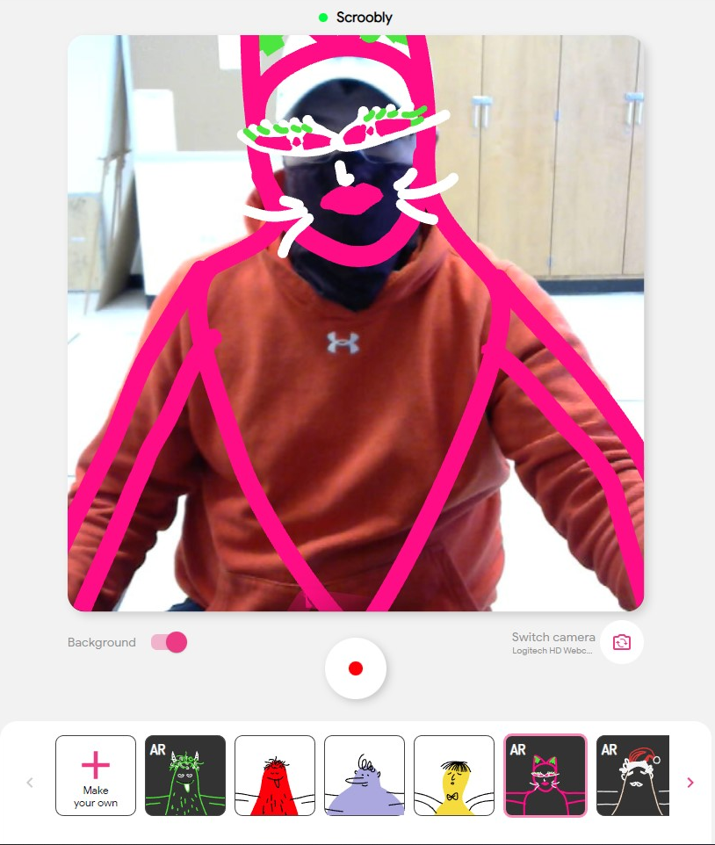
Scroobly
Scroobly is a ML model constructed by Google Partner Innovation and bit.studio
The goal of Scroobly is to coordinate a doodles movements with yours
Scroobly requires access to your camera; please ask for assistance if you have questions about this

Slide 9
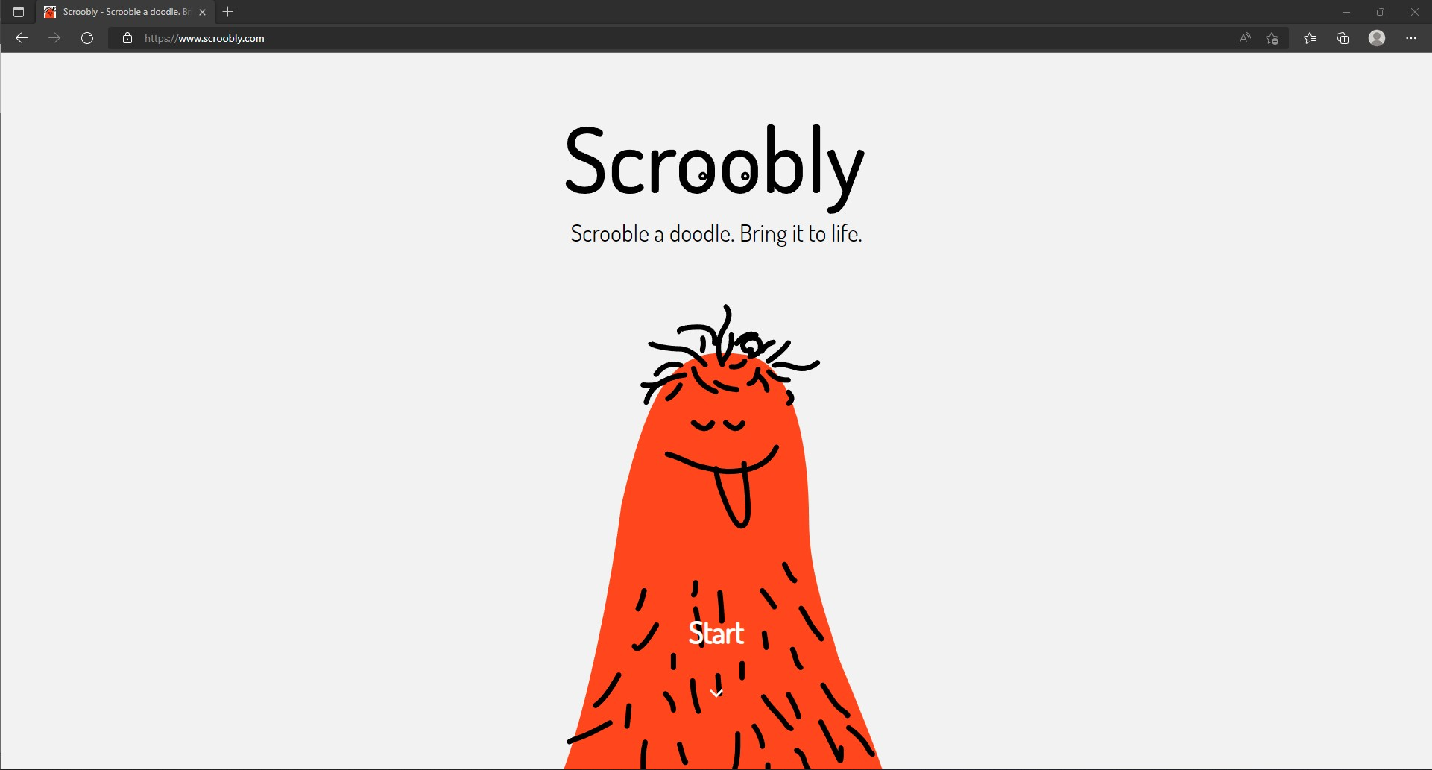
Scroobly
Navigate to the link below using a web browser
https://www.scroobly.com/

Slide 10
Discuss with the person next to you
How well did your doodle track you?
Is there still room for improvement?
Can you guess why this network performs the way it does?

Slide 11
How does this work?
Scroobly is built using two networks!
The network used to track your pose is called PoseNet
PoseNet can identify 32 key point positions on your body to accurately track your movements
The network used to identify your face is called FaceMesh
FaceMesh can identify 468 facial landmarks in real time to estimate facial expressions
Applications for facial recognition include Face ID for phone login, security such as at baseball games, game input such as Microsoft Kinect, etc.

Slide 12
Thing Translator

Slide 13
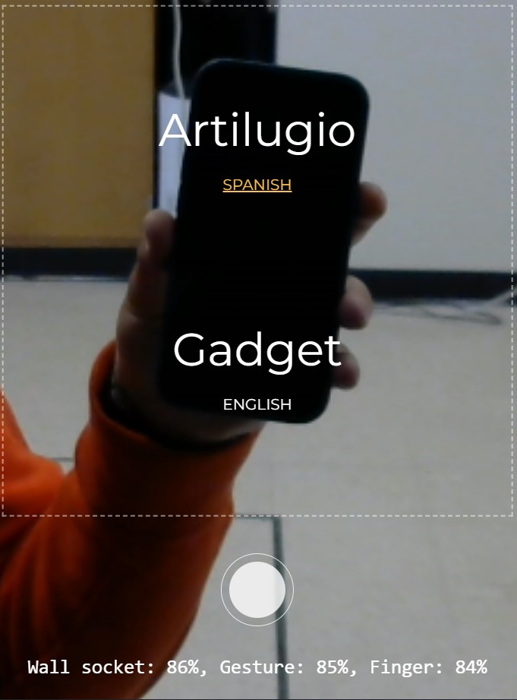
Thing Translator
Thing Translator was created by Dan Motzenbecker and Google Creative Lab
The goal of Thing Translator is to both identify the object in the image and accurately translate the name of that object into different languages
The text at the bottom of the image to the right shows other possible classifications and how confident the network is that they may also fit the image

Slide 14
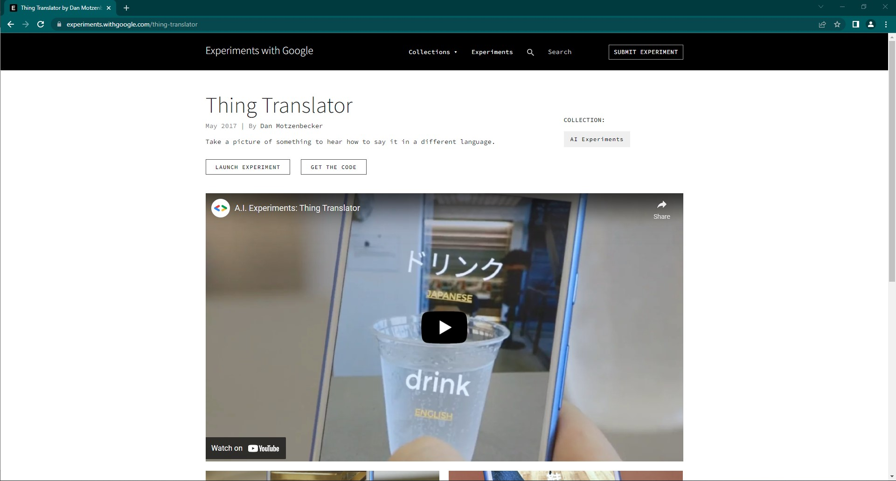
Thing Translator
Navigate to the link below using a web browser
https://thing-translator.appspot.com/

Slide 15
Discuss with the person next to you
How well did the model identify the objects?
Were the translations accurate?
Can you guess why this network performs the way it does?

Slide 16
How does this work?
It uses a convolutional neural network to identify the object and output the objects name
It uses Googles Translator API to translate the predicted name into a desired language
Applications for object recognition include automated sorting, autonomous driving, automated security, such as at baseball games and airports, etc.

Slide 17
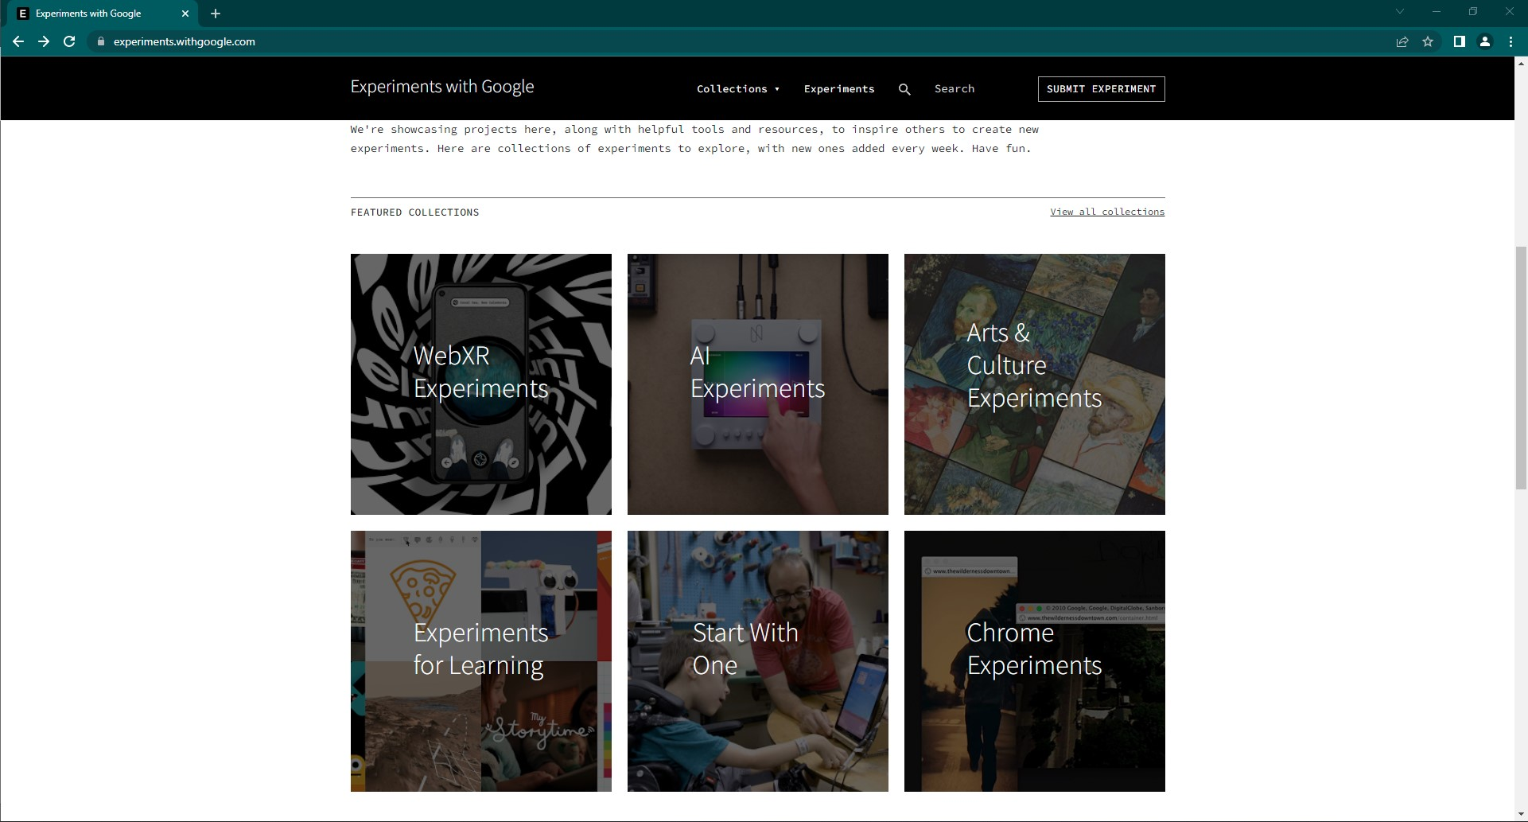
More Experiments…
More fun examples of applications which use Machine Learning can be found at the link below
https://experiments.withgoogle.com/

Slide 18
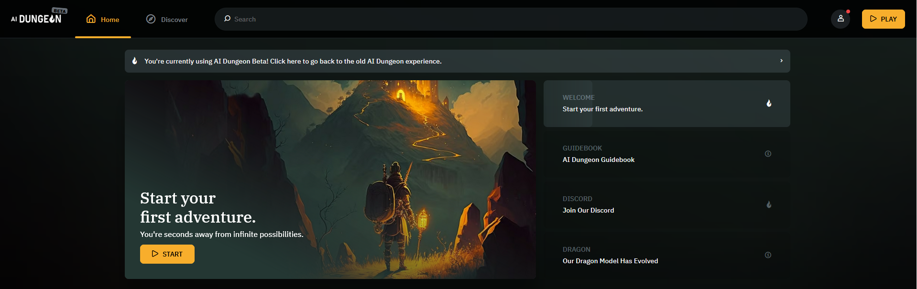
More Experiments…
AI Dungeon – an AI generate dungeon game with infinite possibilities, similar to Dungeons and Dragons
https://beta.aidungeon.com/

Slide 19
Up Next
Intro to ANN

